Slide 1
Big Mountain Ski Resort Strategic Recommendations
Grace Hung
January 2021

Slide 2
Agenda
Problem Identification
Recommendation and Key Findings
Modeling Results and Analysis
Summary and Conclusion

Slide 3
Problem Identification
Big Mountain has been able to charge a price premium historically but we wanted to have a more sophisticated pricing model to better position themselves amongst the market in the future
Wanted to see if certain adjustments with facility offerings and/or cutting costs would be worth it

Slide 4
Recommendations and Key Findings
Pricing model determined Big Mountain could charge more given their existing facility offerings
Big Mountain can explore closing some runs to save costs but need to be careful about revenue impacts
Potential enhancements of adding a run, increasing the vertical drop and installing an additional chair lift could increase yearly revenue projects by over 3 MM, but costs to do and maintain these changes need to be more closely examined

Slide 5
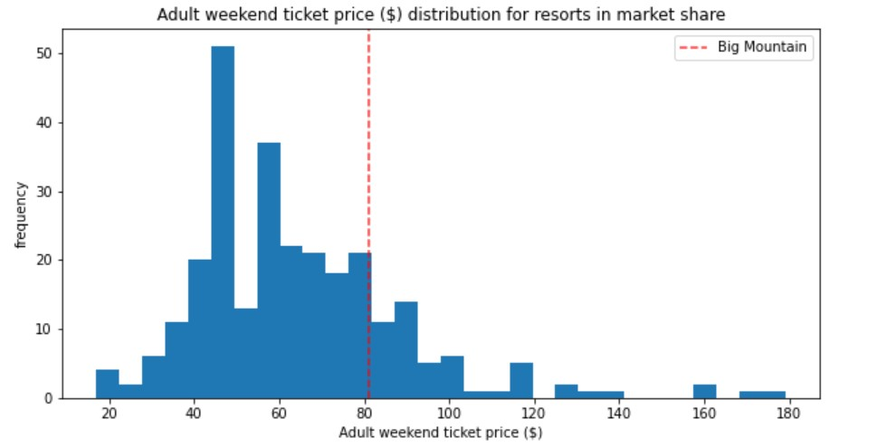
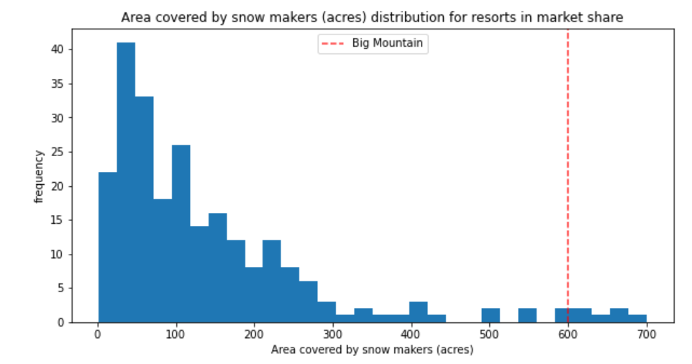
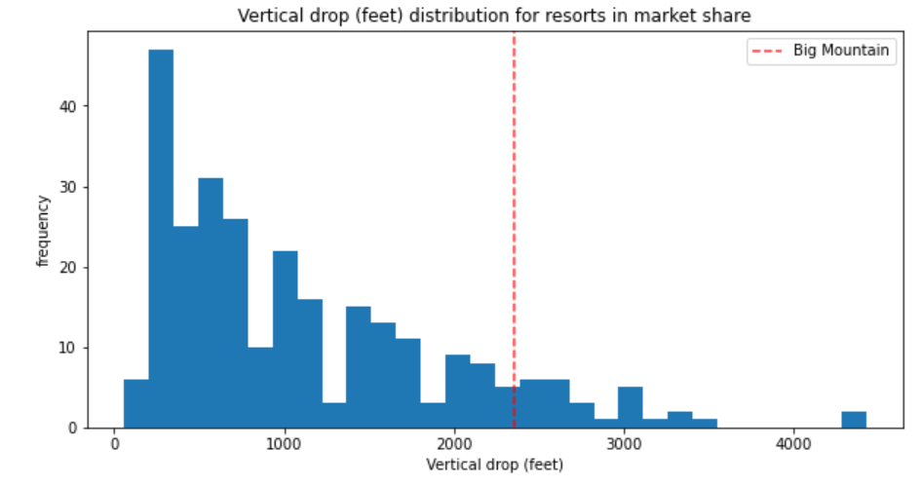
Modeling Results and Analysis
Big mountain is able to charge a premium because they have superior features such as vertical drop and snow making area

Slide 6
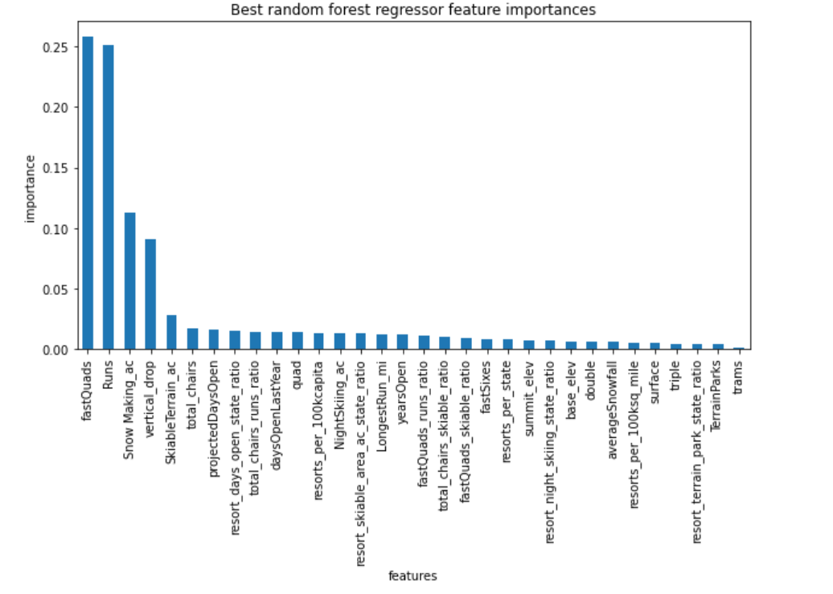
Modeling Results and Analysis
Big Mountain has done well with the top features that predict favorably higher prices like runs, vertical drop and snow making area

Slide 7
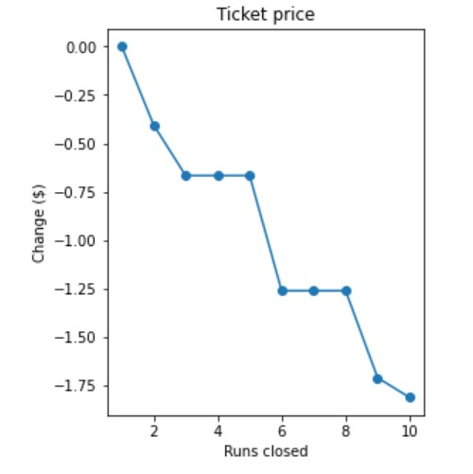
Modeling Results and Analysis Continued...
Caution should be exercised when deciding which runs to close as there may be a corresponding impact to price and therefore revenue
We should also consider if it will affect other features that allow the resort to charge a premium like we should probably avoid closing the run with the highest vertical drop since that justifies higher ticket prices

Slide 8
Summary and Conclusion
Big Mountain should factor in the results from modeling to tweak their prices starting with an initial increase justified by their existing offerings
They can then explore cutting costs by decreasing the number of runs by how much price erosion they are willing to take
Big Mountain can also look at enhancing the facility to justify higher ticket prices by increasing the vertical drop but this may potentially require more capital investment and adjust operational costs so more research needs to be done about the implications

